Slide 1
UNIT III:
Practicing XP: Thinking: Pair Programming,
Energized Work, Informative Workspace,
Root-Cause Analysis, Retrospectives,
Collaborating: Trust, Sit Together, Real Customer Involvement,
Ubiquitous Language, Stand-Up Meetings,
Coding Standards, Iteration Demo,
Reporting, Releasing: "Done Done”, No Bugs,
Version Control,
Ten-Minute Build,
Continuous Integration,
Collective Code Ownership, Documentation.

Slide 2
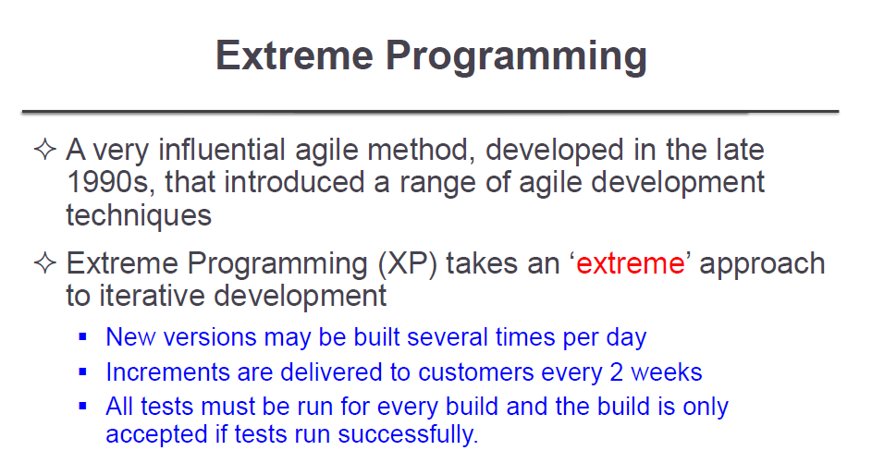

Slide 3
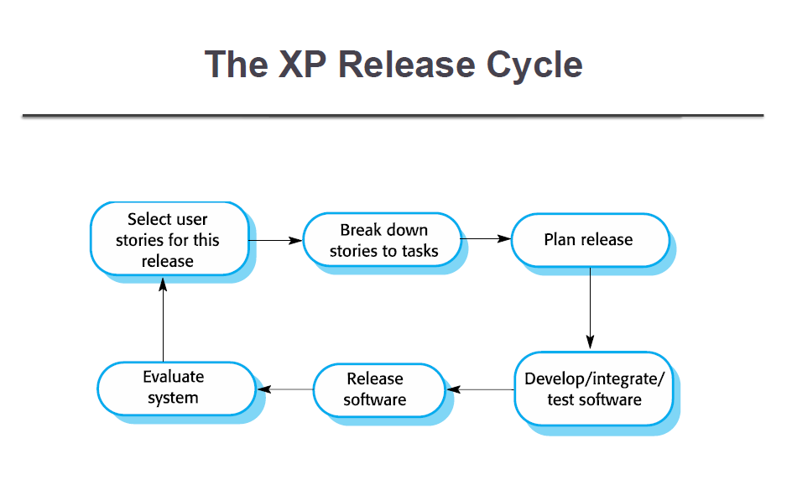

Slide 4
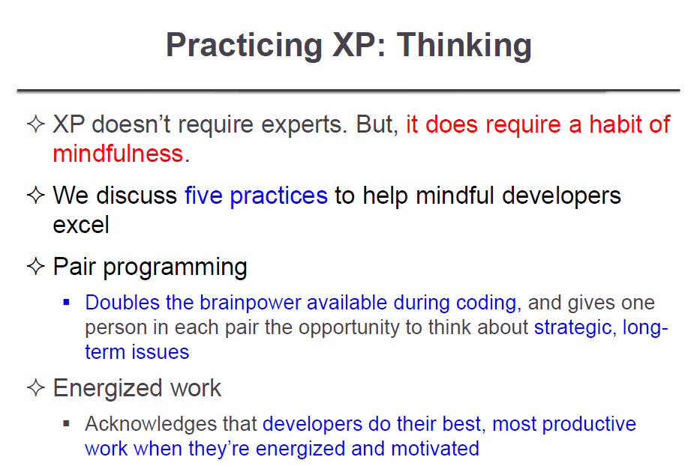

Slide 5
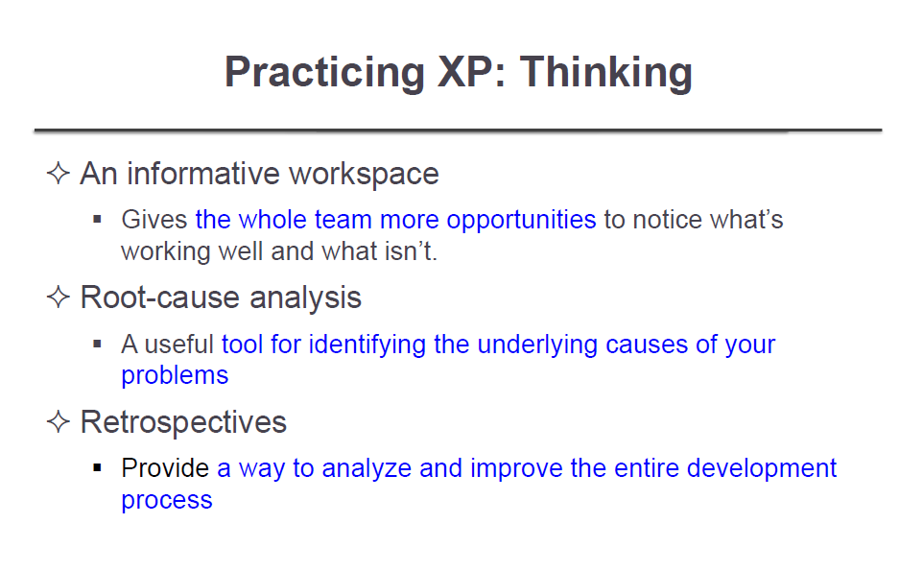

Slide 6
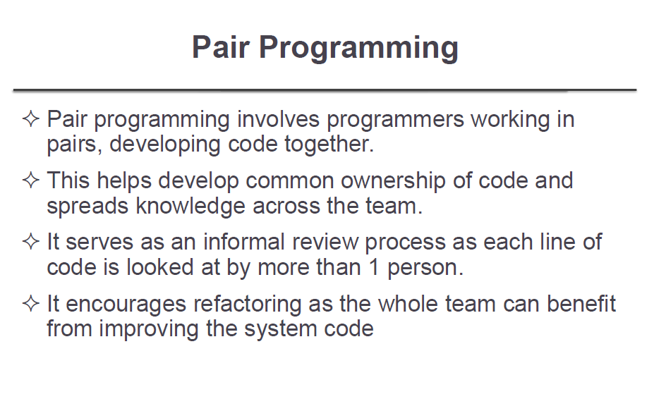

Slide 7
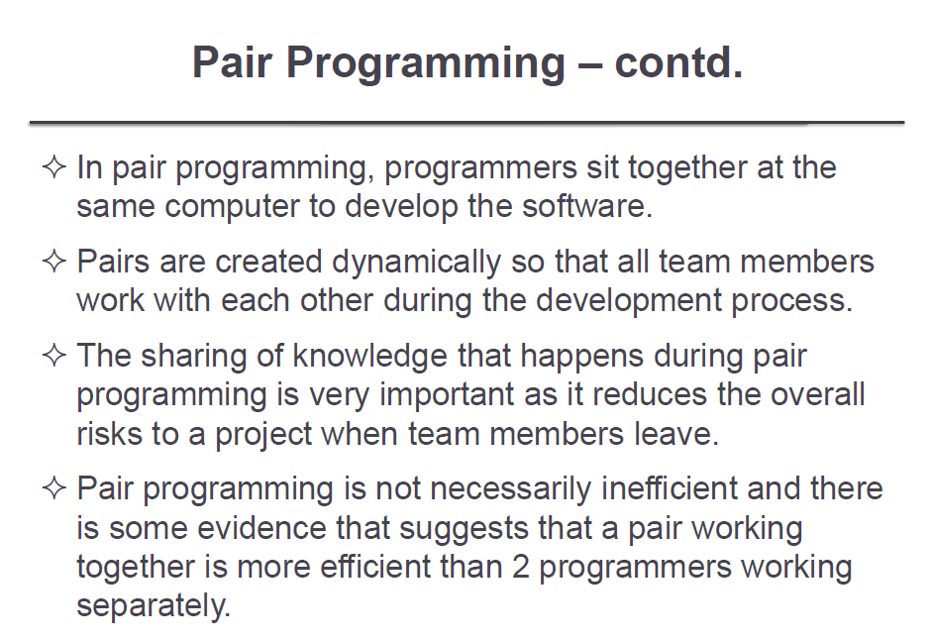

Slide 8
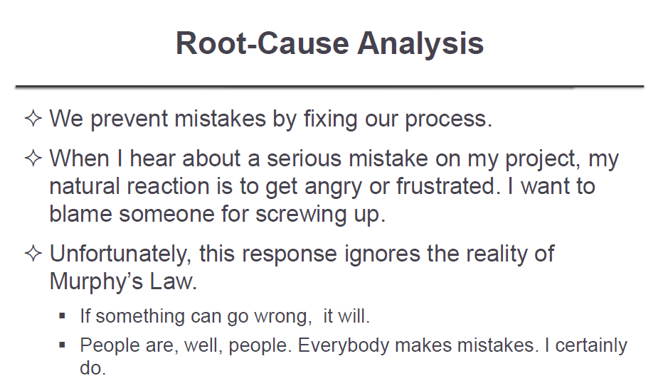

Slide 9
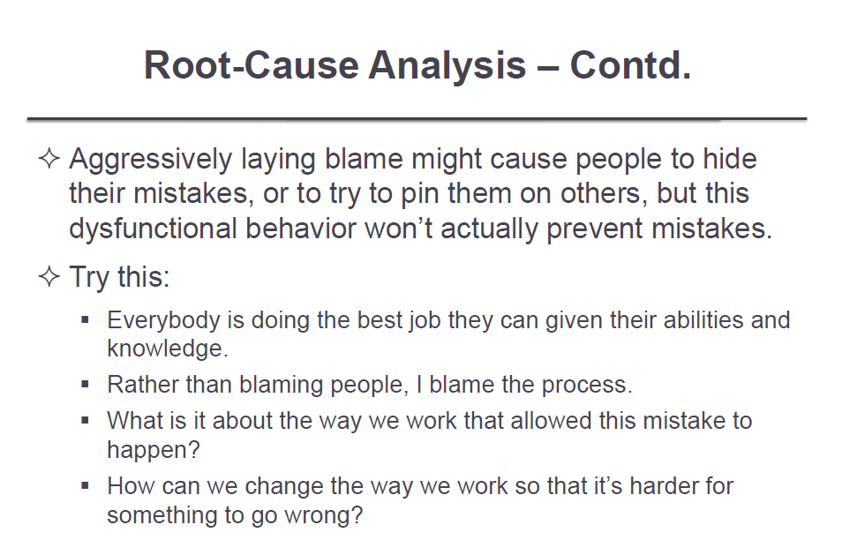

Slide 10
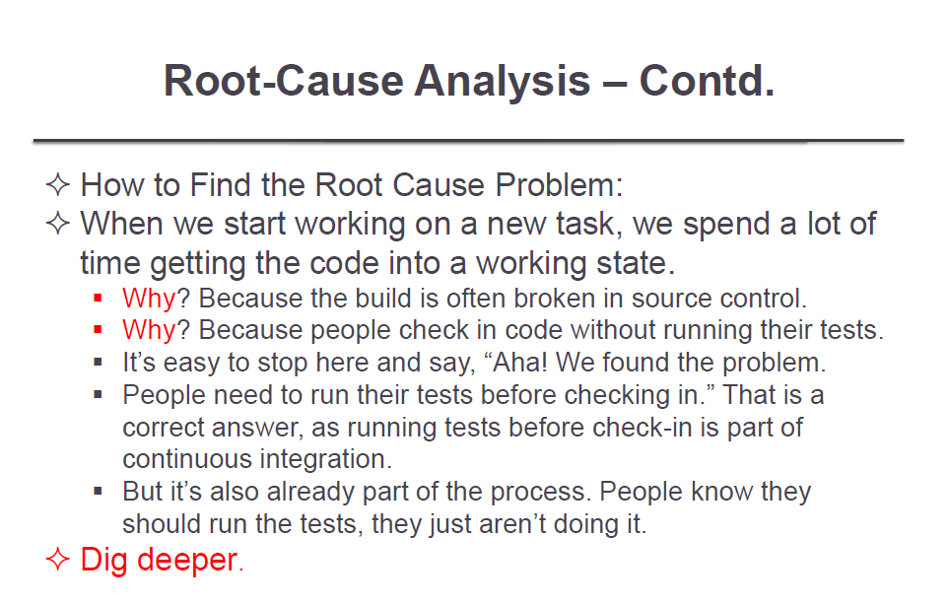

Slide 11
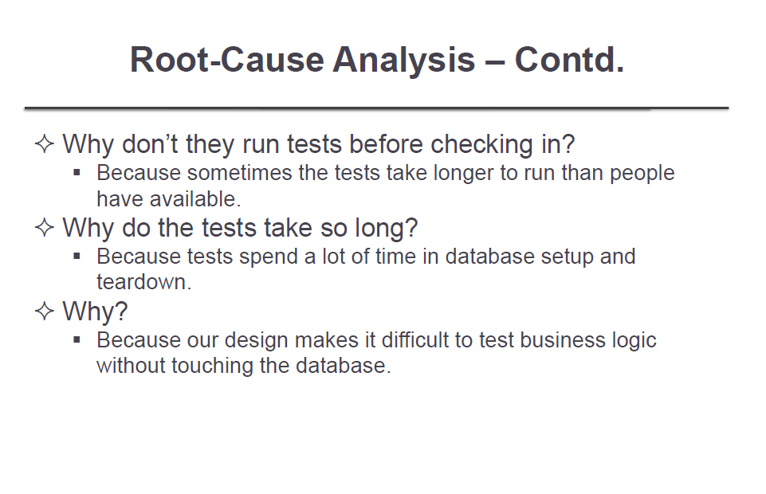

Slide 12
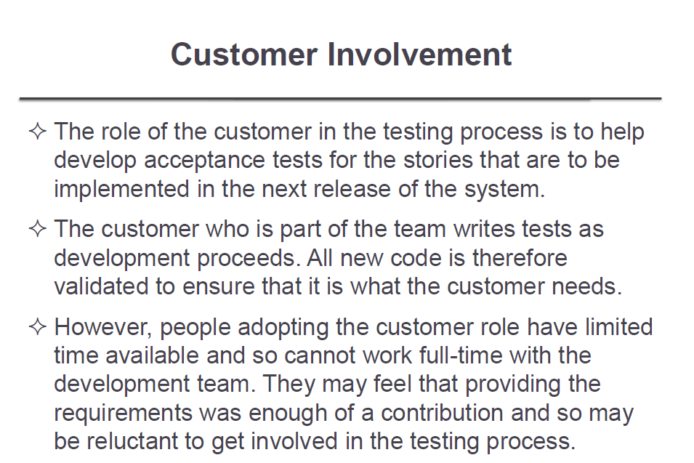

Slide 13
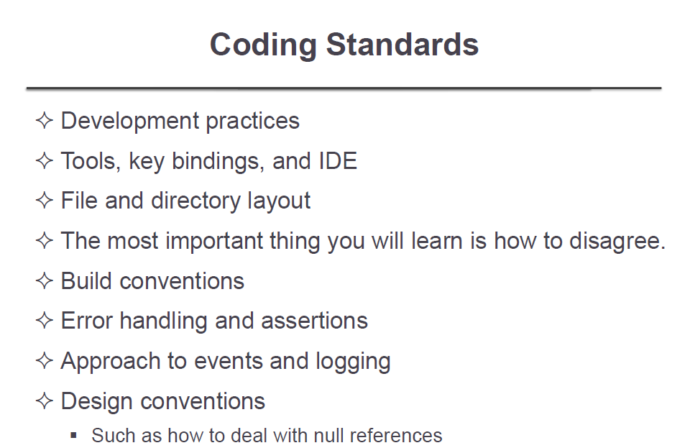

Slide 14
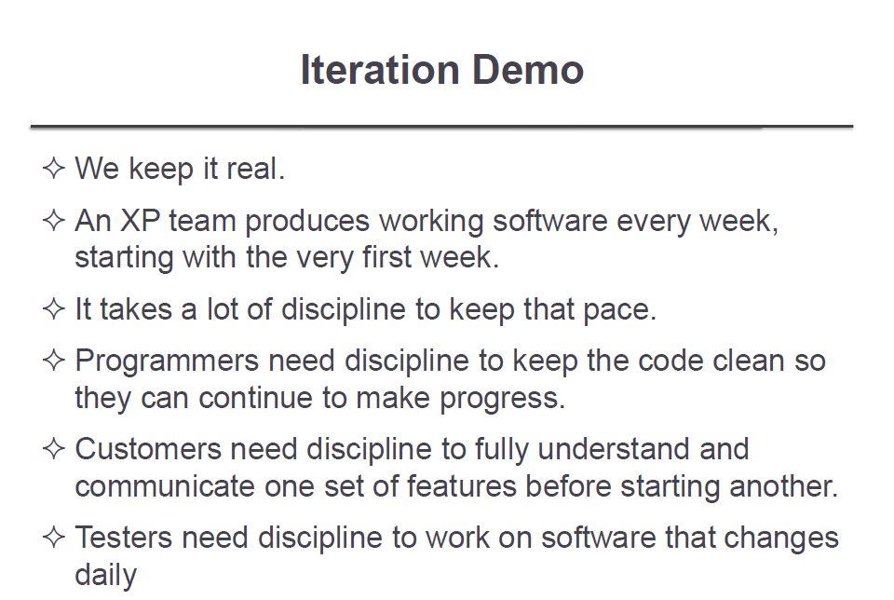

Slide 15
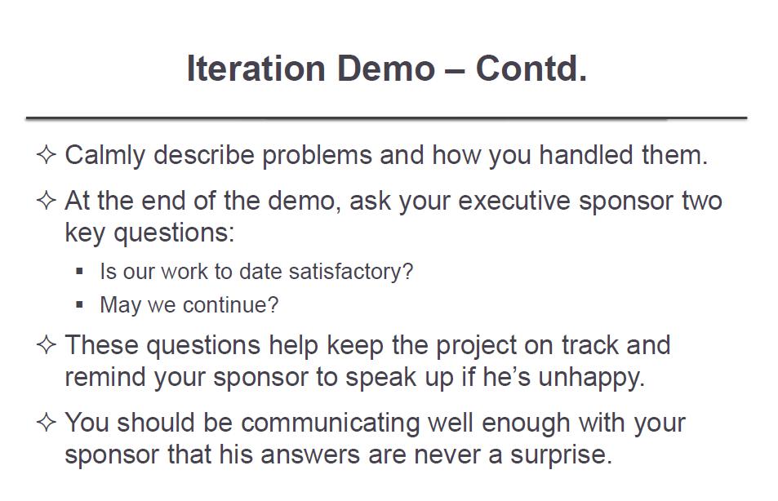

Slide 16
Stand-Up Meetings
We know what our teammates are doing.
I have a special antipathy for status meetings. You know—a manager reads a list of tasks and asks about each one in turn. They seem to go on forever, although my part in them is typically only five minutes. I learn something new in perhaps ten of the other minutes. The remaining 45 minutes are pure waste.
There's a good reason that organizations hold status meetings: people need to know what's going on. XP projects have a more effective mechanism: informative workspaces and the daily stand-up meeting.

Slide 17
It comes from an agile process also called Scrum. In the Daily Scrum, participants specifically answer three questions:
What did I do yesterday?
What will I do today?
What problems are preventing me from making progress?
I prefer an informal approach, but both styles are valid. Try both and use whichever approach works best for you.
Don't wait for the stand-up to start your day.
One problem with stand-up meetings is that they interrupt the day. This is a particular problem for morning stand-ups: because team members know the meeting will interrupt their work, they sometimes wait for the stand-up to end before starting to work. If people arrive at different times, early arrivals sometimes just waste time until the stand-up starts. You can reduce this problem by moving the stand-up to later in the day, such as just before lunch.

Slide 18
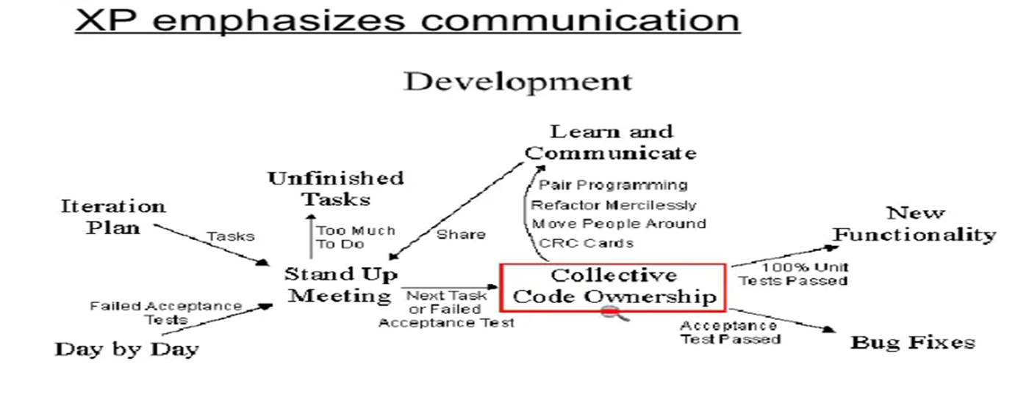
Communication among the entire team is the purpose of the stand up meeting.
A stand up meeting every morning is used to communicate problems, solutions, and promote team focus.
Everyone stands up in a circle to avoid long discussions. It is more efficient to have one short meeting that every one is required to attend than many meetings with a few developers each.
During a stand up meeting developers report at least three things; what was accomplished yesterday, what will be attempted today, and what problems are causing delays.
The daily stand up meeting is not another meeting to waste people's time.
It will replace many other meetings giving a net savings several times its own length

Slide 19
Releasing
What is the value of code? Agile developers value "working software over comprehensive documentation."¹ Does that mean a requirements document has no value? Does it mean unfinished code has no value?

Slide 20
In order to meet commitments and take advantage of opportunities, you must be able to push your software into production within minutes. This chapter contains seven practices that give you leverage to turn your big release push into a ten-minute tap:
"Done Done" ensures that completed work is ready to release.
No Bugs allows you to release your software without a separate testing phase.
Version Control allows team members to work together without stepping on each others' toes.
A Ten-Minute Build builds a tested release package in under ten minutes.
Continuous Integration prevents a long, risky integration phase.
Collective Code Ownership allows the team to solve problems no matter where they may lie.
Post-hoc Documentation decreases the cost of documentation and increases its accuracy.

Slide 21
"Done Done" done when we're production-ready
Partially-finished stories result in hidden costs to your project. When it's time to release, you have to complete an unpredictable amount of work. This destabilizes your release planning efforts and prevents you from meeting your commitments.
To avoid this problem, make sure all of your planned stories are "done done" at the end of each iteration. You should be able to deploy the software at the end of any iteration, although normally you'll wait until more features have been developed.
What does it take for software to be "done done"? That depends on your organization. I often explain that a story is only complete when the customers can use it as they intended. Create a checklist that shows the story completion criteria. I write mine on the iteration planning board:

Slide 22
Tested (all unit, integration, and customer tests finished)
Coded (all code written)
Designed (code refactored to the team's satisfaction)
Integrated (the story works from end to end—typically, UI to database—and fits into the rest of the software)
Builds (the build script includes any new modules)
Installs (the build script includes the story in the automated installer)
Migrates (the build script updates database schema if necessary; the installer migrates data when appropriate)
Reviewed (customers have reviewed the story and confirmed that it meets their expectations)
Fixed (all known bugs have been fixed or scheduled as their own stories)
Accepted (customers agree that the story is finished)

Slide 23
How to Be "Done Done"
Use test-driven development to combine testing, coding, and designing.
When working on an engineering task, make sure it integrates with the existing code. Use continuous integration and keep the ten-minute build up to date.
Create an engineering task for updating the installer and have one pair work on it in parallel with the other tasks for the story.
Just as importantly, include your on-site customers in your work.
As you work on a UI task, show a customer what the screen will look like, even if it doesn't work yet. Customers often want to tweak a UI when they see it for the first time. This can lead to a surprising amount of last-minute work if you delay any demos to the end of the iteration.

Slide 24
The Art of Agile Development: No Bugs
Rather than fixing bugs, agile methods strive to prevent them.
Test-driven development structures work into easily-verifiable steps.
Pair programming provides instant peer review, enhances brainpower, and maintains self-discipline.
Energized work reduces silly mistakes.
Coding standards and a "done done" checklist catch common errors.
On-site customers clarify requirements and discover misunderstandings.
Customer tests communicate complicated domain rules.
Iteration demos allow stakeholders to correct the team's course.
Simple design, refactoring, slack, collective code ownership, and fixing bugs early eliminates bug breeding grounds.
Exploratory testing discovers teams' blind spots, and root-cause analysis allows teams to eliminate them.

Slide 25
How to Achieve Nearly Zero Bugs
use "defect" synonymously with "bug".
The agile approach is to generate fewer defects. This isn't a matter of finding defects earlier; it's a question of not generating them at all.

Slide 26
To achieve these results, XP uses a potent cocktail of techniques:
Write fewer bugs by using a wide variety of technical and organizational practices.
Eliminate bug breeding grounds by refactoring poorly-designed code.
Fix bugs quickly to reduce their impact, writing tests to prevent them from reoccurring, then fix the associated design flaws that are likely to breed more bugs.
Test your process by using exploratory testing to expose systemic problems and hidden assumptions.
Fix your process by uncovering categories of mistakes and making those mistakes impossible.

Slide 27
The Art of Agile Development: Version Control
A version control system provides a central repository which helps coordinate changes to files and also provides a history of changes.
A project with version control uses the version control system to mediate changes.
It's an orderly process in which developers get the latest code from the server, do their work, run all of the tests to confirm that their code works, then check in their changes. This process, called continuous integration, occurs several times a day for each pair.
To support collective ownership, use a concurrent model of version control.
Support time travel by storing tools, libraries, documentation, and everything else related to the project in version control. (On-site customers' files, too.)

Slide 28
We keep all of our project artifacts in a single, authoritative place.
To work as a team, you need some way to coordinate your source code, tests, and other important project artifacts.
A project without version control may have snippets of code scattered among developer machines, networked drives, and even removable media. Keep the entire project in a single repository.
Instead, use configuration files and build scripts to support multiple configurations.
Keep your repository clean: never check in broken code.
All versions should build and pass all tests. "Iteration" versions are ready for stakeholders; "release" versions are production-ready.

Slide 29
Version Control Terminology
Different version control systems use different terminology. Here are the terms used
Repository
The repository is the master storage for all of your files and and their history. It's typically stored on the version control server. Each stand-alone project should have its own repository.
Sandbox
Also known as a working copy, a sandbox is what team members work out of on their local development machines. (Don't ever put a sandbox on a shared drive. If other people want to develop, they can make their own sandbox.) The sandbox contains a copy of all the files in the repository from a particular point in time.
Check out
To create a sandbox, check out a copy of the repository. In some version control systems, this term means "update and lock".

Slide 30
Update
Update your sandbox to get the latest changes from the repository. You can also update to a particular point in the past.
Lock
A lock prevents anybody from editing a file but you.
Check in or commit
Check in the files in your sandbox to save them into the repository.
Revert
Revert your sandbox to throw away your changes and return to the point of your last update. This is handy when you've broken your local build and can't figure out how to get it working again. Sometimes reverting is faster than debugging, especially if you have check in recently.
Tip or head
The tip of the repository contains the latest changes that have been checked in. When you update your sandbox, you get the files at the tip. (This changes somewhat when you use branches.)
Tag or label
A tag marks a particular time in the history of the repository, allowing you to easily access it again.
Roll back
Roll back a check-in to remove it from the tip of the repository. The mechanism for doing so varies depending on the version control system you use.

Slide 31
The Art of Agile Development: Continuous Integration
Keep code integrated and build release infrastructure with the rest of the application. The ultimate goal is to be able to deploy all but the last few hours of work at any time.
To do so, integrate every few hours and keep your build, test, and other release infrastructure up to date. Each integration should get as close to a real release as possible.

Slide 32
How to Practice Continuous Integration
In order to be ready to deploy all but the last few hours of work, your team needs to do two things:
Integrate your code every few hours.
Keep your build, tests, and other release infrastructure up to date.
Test-Driven Development
To integrate, update your sandbox with the latest code from the repository, make sure everything builds, then commit your code back to the repository. You can integrate any time you have a successful build. With test-driven development, that should happen every few minutes. integrate whenever you make a significant change to the code or create something.

Slide 33
Collective Code Ownership
We are all responsible for high quality code.
Collective code ownership spreads responsibility for maintaining the code to all the programmers.
Collective code ownership is exactly what it sounds like: everyone shares responsibility for the quality of the code. No single person claims ownership over any part of the system, and anyone can make any necessary changes anywhere.
Fix problems no matter where you find them.
In fact, improved code quality may be the most important part of collective code ownership.
Collective ownership allows—no, expects—everyone to fix problems they find. If you encounter duplication, unclear names, or even poorly designed code, it doesn't matter who wrote it. It's your code. Fix it!

Slide 34
The Art of Agile Development: Documentation
Projects use three main types of documents:
work-in-progress; product; hand-off.
Work-in-progress documents communicate, and other forms of communication may replace them. High-bandwidth communication replaces some work-in-progress documents. Test-driven development creates executable low-level design specifications. Customer tests describe high-level behavior, and a ubiquitous language further clarifies intent.
Product documents have business value--schedule them with stories.
Handoff documents are best and most accurate at the end of the project. Set aside time after delivery to create them, and consider conducting an incremental handoff using pair programming and collective ownership.

